Slide 1
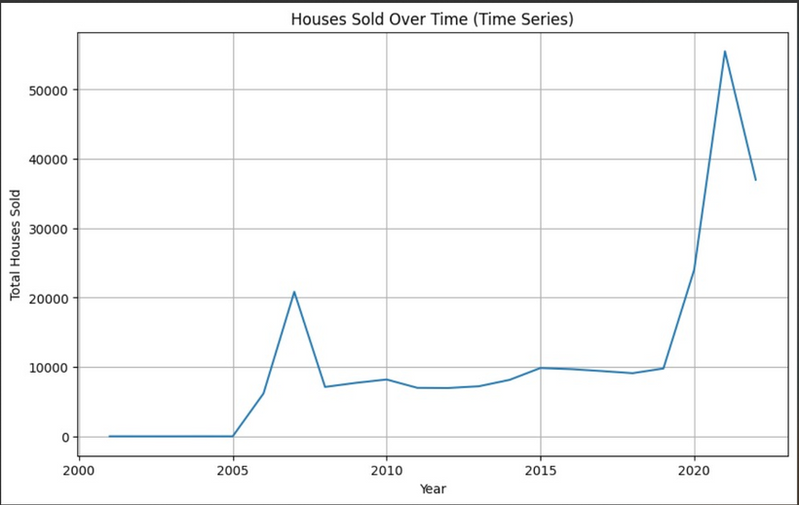
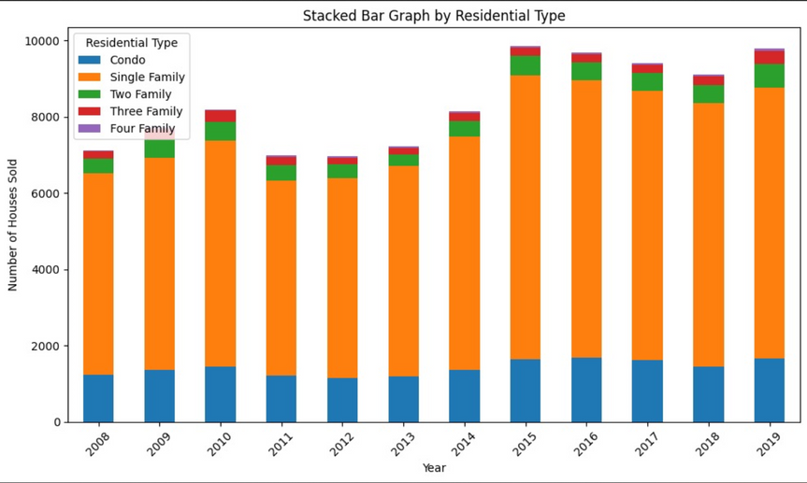
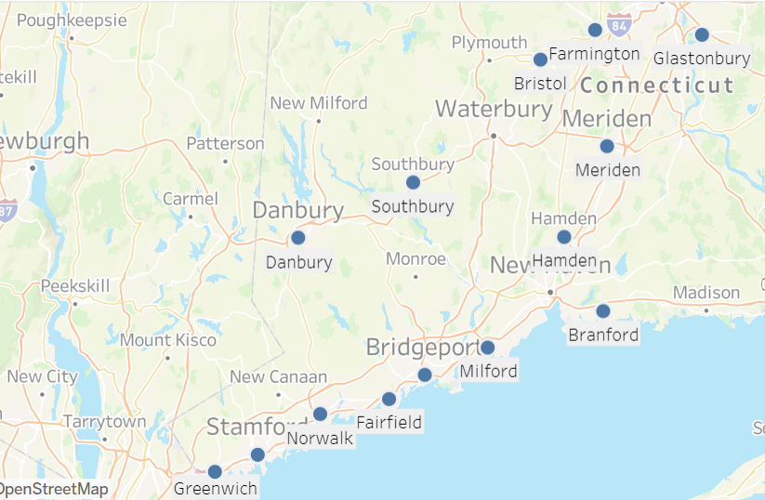
Exploratory Data Analysis - Research Question 1
According to our exploratory data analysis, the house sales pattern between 2008 and 2019 appears to follow a normal distribution..
Within the categories of residential types, there appears to be a greater abundance of data for single-family homes and condos compared to other types.
To ensure accuracy in our analysis and predictions, we will focus our data scope on the top ten towns with the highest number of single-family homes and the top ten towns with the highest number of condos.

Slide 2
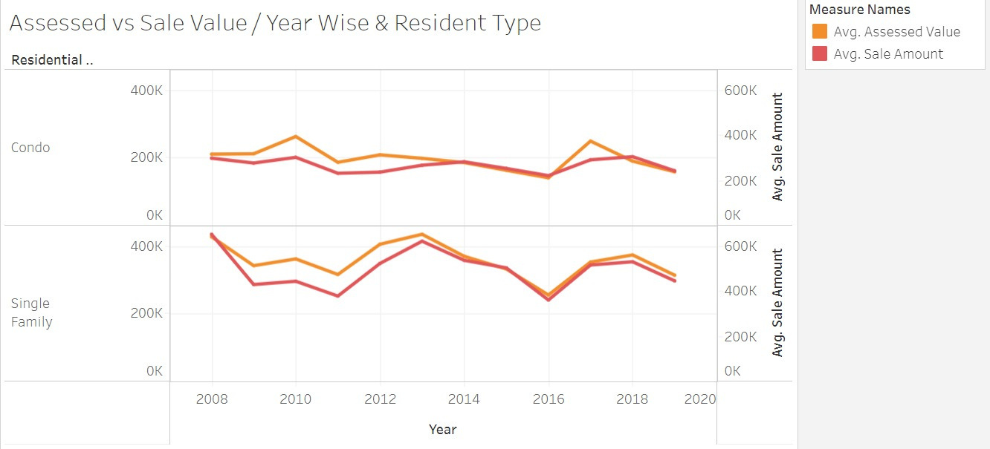
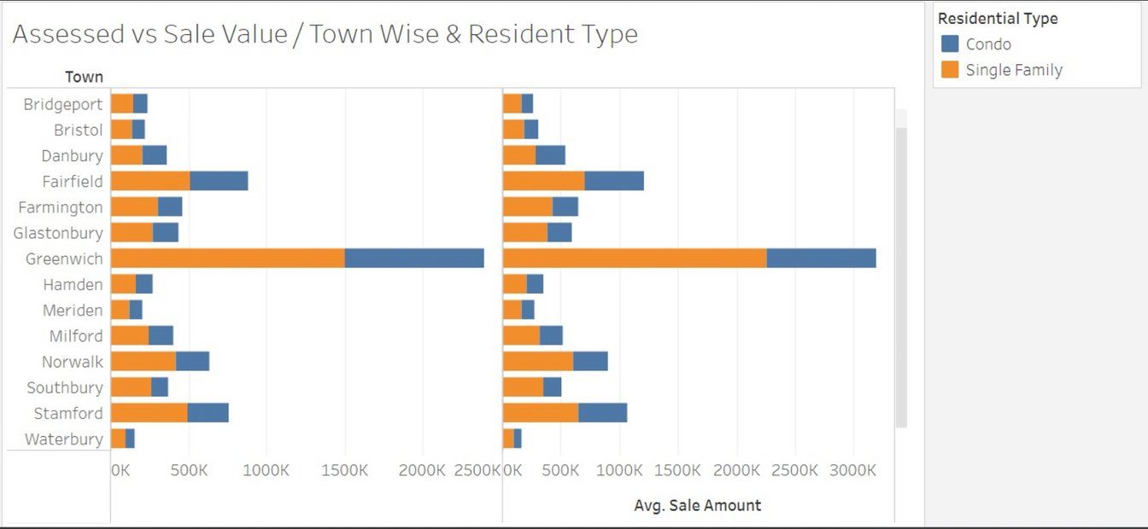
Exploratory Data Analysis - Research Question 1
Our exploratory data analysis shows the correlation between assessed and sale values across different years for single-family and condo houses after filtering based on selected towns.
After filtering based on the years chosen, our exploratory data analysis shows the correlation between assessed and sale values across selected towns for different residential types of single-family and condo houses.

Slide 3
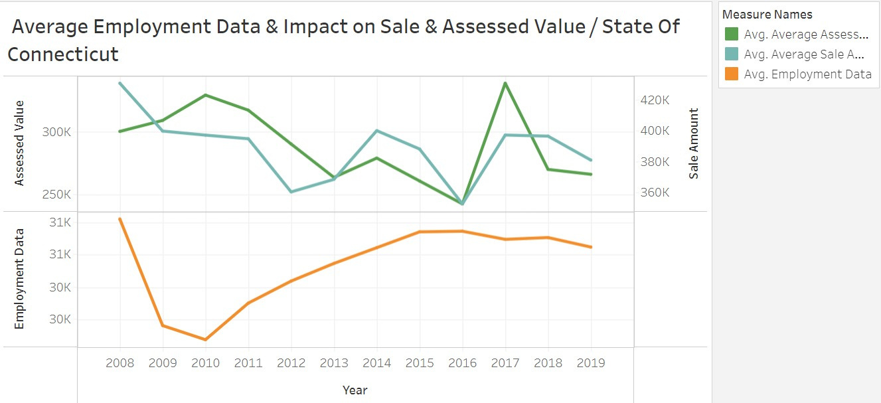
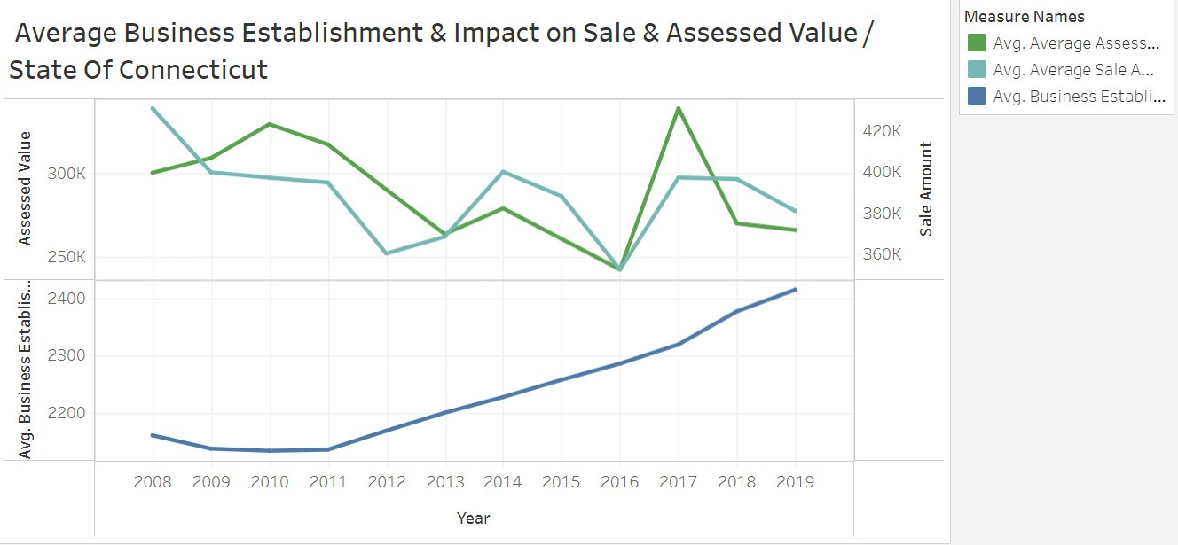
Exploratory Data Analysis - Research Question 1
Our exploratory data analysis shows the correlation between assessed and sale values and its impact on Employment Data and Number of Business Establishment, grouped Yearwise and Townwise

Slide 4
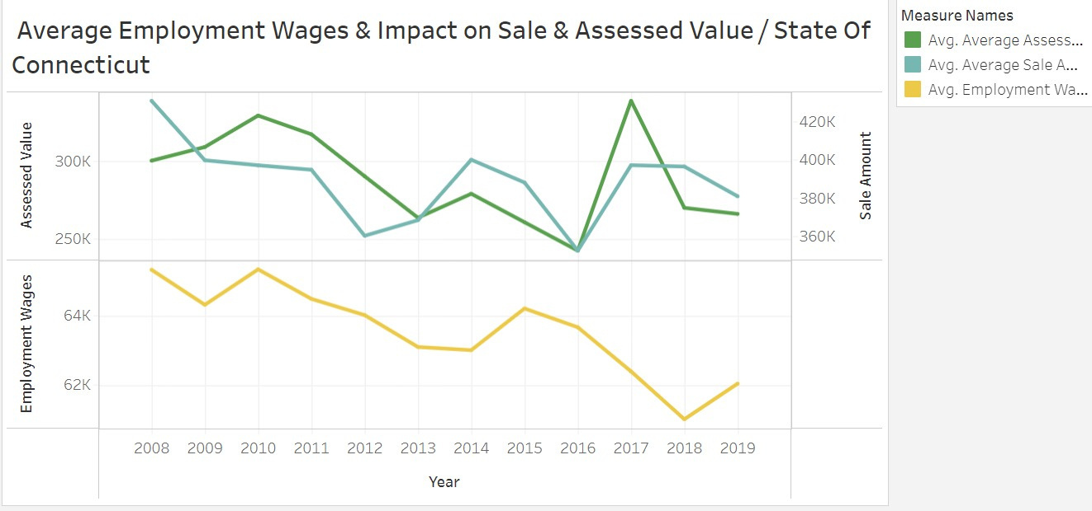
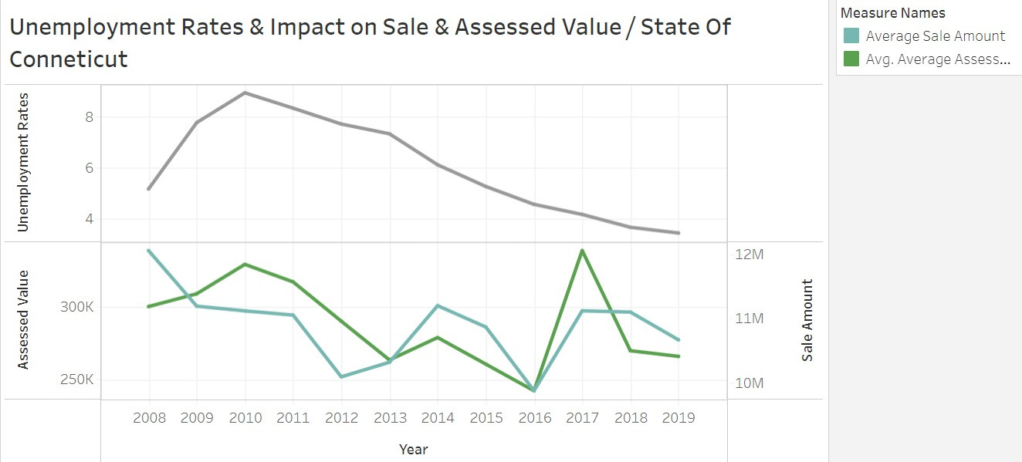
Exploratory Data Analysis - Research Question 1
Our exploratory data analysis shows the correlation between assessed and sale values and its impact on Unemployment Data and Employee Wages, grouped Yearwise and Townwise

Slide 5
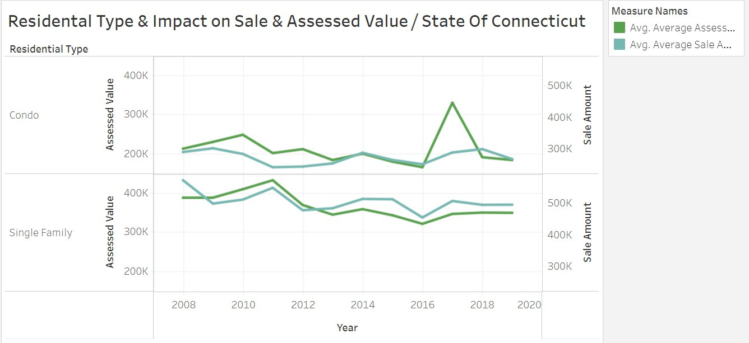
Exploratory Data Analysis - Research Question 1
Our exploratory data analysis shows the correlation between assessed and Sale values and Assessed Value over time for different Residental Types

Slide 6
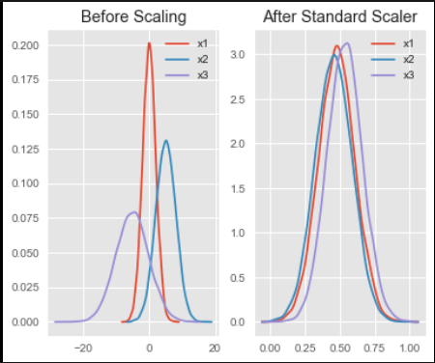








Predicting Sale and Assessed Values Based on Economic Factors in State of Connecticut
Statistical Tests
Scalar Normalization
Forecasting Metrics
Average Sale Value
Average Assessed Values
ARIMA Modelling
Feature Selection
Average Assessed Values
Average Sale Value
Business Establishments
UnemploymentRate
EmployeeWages
EmployeeCount
S3 Bucket
Diagnostic Tests

Slide 7
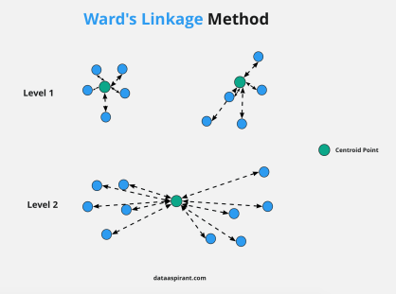
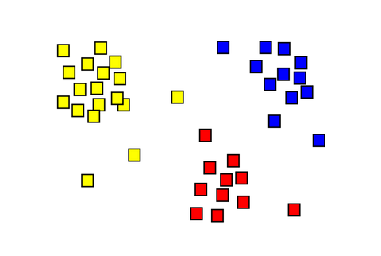
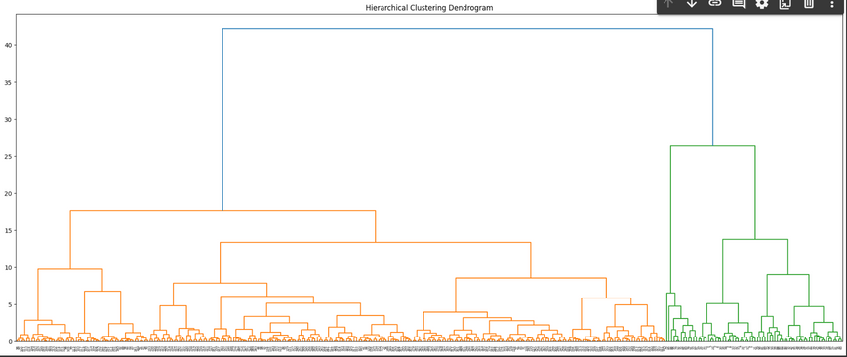
Clustering Based on Economic Factors And Understanding Its Impacts on Sale Amount & Assessed Value
Scalar Normalization
Ward’s Linkage Method
Feature Selection
Clusters
Average Assessed Values
Average Sale Value
Business Establishments
UnemploymentRate
EmployeeWages
EmployeeCount
S3 Bucket
Dendogram Analysis

Slide 8
Predicting Sale and Assessed Values Based on Social Factors in State of Connecticut
Statistical Tests
Scalar Normalization
Forecasting Metrics
Average Sale Value
Average Assessed Values
ARIMA Modelling
Feature Selection
Average Assessed Values
Average Sale Value
Schools
Heathcare Centers
Criminal Cases
S3 Bucket
Diagnostic Tests

Slide 9
Clustering Based on Social Factors And Understanding Its Impacts on Sale Amount & Assessed Value
Scalar Normalization
Ward’s Linkage Method
Feature Selection
Clusters
Average Assessed Values
Average Sale Value
Schools
Healthcare Centers
Criminal Cases
Criminal Count / Million
S3 Bucket
Dendogram Analysis

